Slide 1
The Weimar Republic
L.Os
Explain why the SPD and the KPD were enemies after the Spartacist Revolt.
List four strengths and weaknesses fo the Weimar Republic
Explain why most people did not support the Weimar Republic.

Slide 2
CONSERVATISM/ NATIONALISM
SOCIALISM
All these parties can exist in a DEMOCRACY and people can choose to vote for them
Left wing political parties
Right wing political parties
LIBERALISM
centre
Believe in keeping customs & values
Opposed to change
Believe in private enterprise/ business
Authority
Military/ force
Racist & nationalist
Believe in state control of industry
Worker’s rights
Equality & fairness
A TOTALITARIAN SOCIETY can be either extreme right wing or extreme left wing. Only one political party/ person rules and no opposition or choice is tolerated= DICTATORSHIP
NAZISM
MARXISM
FASCISM
COMMUNISM
Free speech, thought, voting, movement etc.

Slide 3
THE WEIMAR CONSTITUTION
The constitution was written in Weimar, a town in Germany.
It was a ‘guide book’ on how governments would be elected. It said:
what their powers would be
what rights German people would have
The title ‘Weimar Germany’ or the ‘Weimar Republic’ refers to a time between 1919 and 1933 when Germany was a Republic ruled by elected representatives. The new democratic republic created a constitution which tried to be fair to everyone but it had serious weaknesses.

Slide 4
January 1919- Germans voted for a National Assembly
(Ebert’s govt had been a ‘care taker’ or provisional govt up until this point)
Task of writing a constitution for Germany
Strengths and weaknesses
Ebert elected as President of the German Republic
Germany was now a DEMOCRATIC REPUBLIC
Its representatives would now meet in the REICHSTAG (parliament)

Slide 5
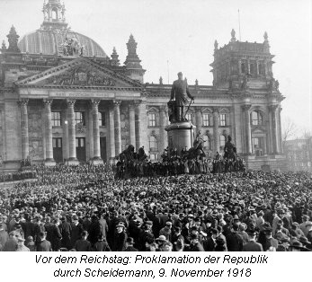

Slide 6
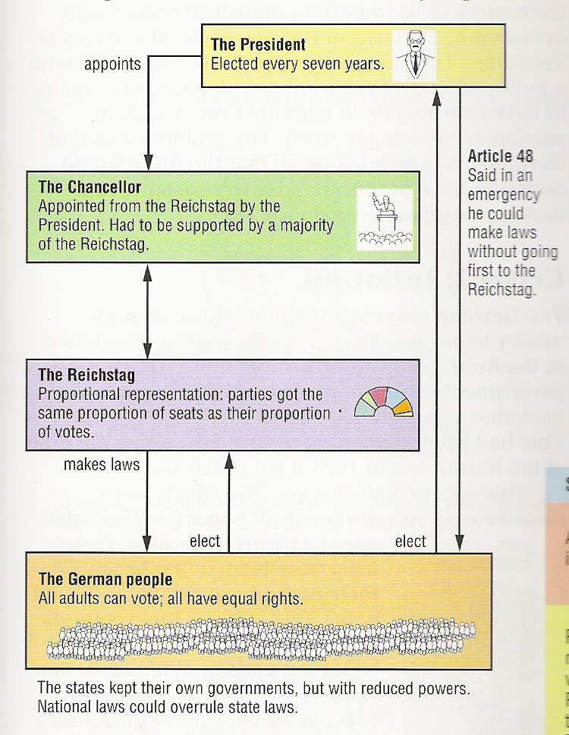
How the Weimar Republic was set up
Powerful Head of State (the Republic)
These powers could be very dangerous
Head of government
Parliament
Democracy

Slide 7
The Reichstag was to be elected every 4 years by PROPORTIONAL REPRESENTATION
WEAKNESSES
STRENGTHS
Unlikely that 1 party would get an overall majority. So governments were coalitions- 2 or more parties ruling together.
It was FAIR- many opinions could be heard as each political party won seats in the Reichstag according to its votes.
Therefore it was difficult to agree on policy and carry out changes.
No vote was wasted- all votes counted
Extreme left or right wing parties eg Nazis, could gain a few seats in the Reichstag and put forward their ideas= more support
Historians have criticised PR saying it led to the collapse of the Weimar Republic

Slide 8
You need to know!!!!
Germans associated the new democracy with defeat and disgrace. Many political parties in the Reichstag were enemies of the democratic Republic.
Left wing
Right wing
Many Germans did not believe that this new system of government could give them the strong leadership that they had been used to with the Kaiser, and thought that it was weak. Few people were loyal to the Weimar Republic and would defend it.
For every strength of the Weimar Republic there was a weakness that would eventually lead to its downfall.

Slide 9
POTENTIAL PROBLEMS FACING THE WEIMAR REPUBLIC
1. Many people in powerful positions eg judges, police chiefs etc were right wing and still supported the Kaiser and had no respect for democracy.
2. Germany’s democratic politicians were called the ‘November Criminals’ by opponents of the new govt and the Kaiser’s supporters. The ‘Stab in the back theory’
3. 1919- 1923- Germany had 9 shortlived coalition governments. Many Germans began to say that democracy was politically weak & unstable, as well as accepting defeat and humiliation for Germany.
4. Article 48 of the constitution gave the German President the power to announce a state of emergency and make laws by himself without the Reichstag.

Slide 10
ES THE WEIMAR CONSTITUTION
This source is from the diary of a German army officer writing in 1919
‘Democracy! There was no democracy when Germany was great under the Kaiser. Now Germany’s leaders must listen to the voice of every shop keeper and farm labourer, along with their women. The backbone of Germany is its landowners and its army officers. They alone should have power!’
Q. What is the attitude of the ex army officer in the source to the new democratic government? 4

